Slide 1
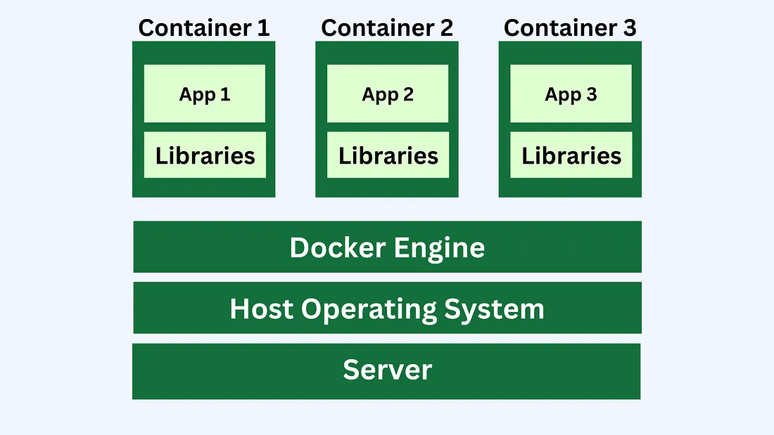
Docker
A platform for building, packaging, and running applications in lightweight containers.
Ensures consistency across environments ("works on my machine" solved).
Why it matters?
Portability
Speed.
Reproducibility
Easier DevOps workflows

Slide 2
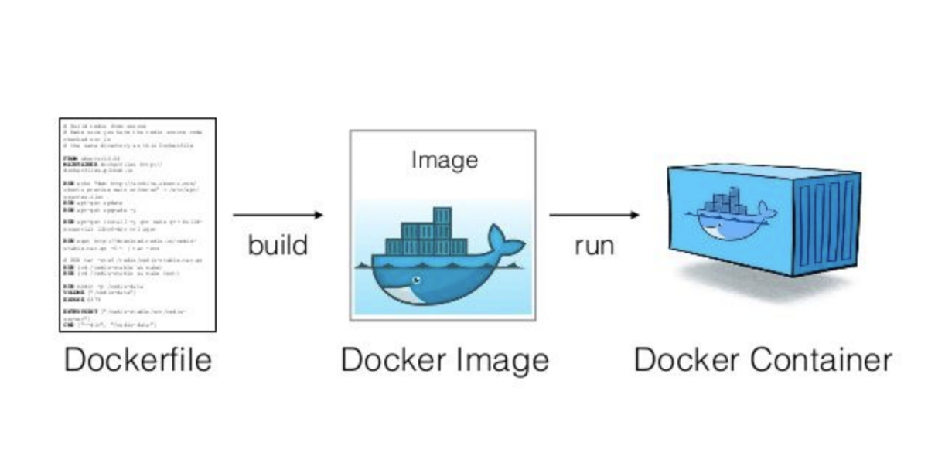
Key Concepts (High-Level Overview)
Images
Containers.
Dockerfile
Docker Engine
Docker Hub
Volumes
Networks

Slide 3
What is an Image?
A read-only template containing instructions for creating containers.
Built from a Dockerfile.
Can be stored in registries (Docker Hub, GitHub Packages, AWS ECR).
Examples:
node:18-alpine
python:3.12-slim
mysql:8.0

Slide 4
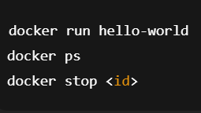
What is a Container?
A running instance of an image.
Lightweight, isolated, uses shared OS kernel.

Slide 5
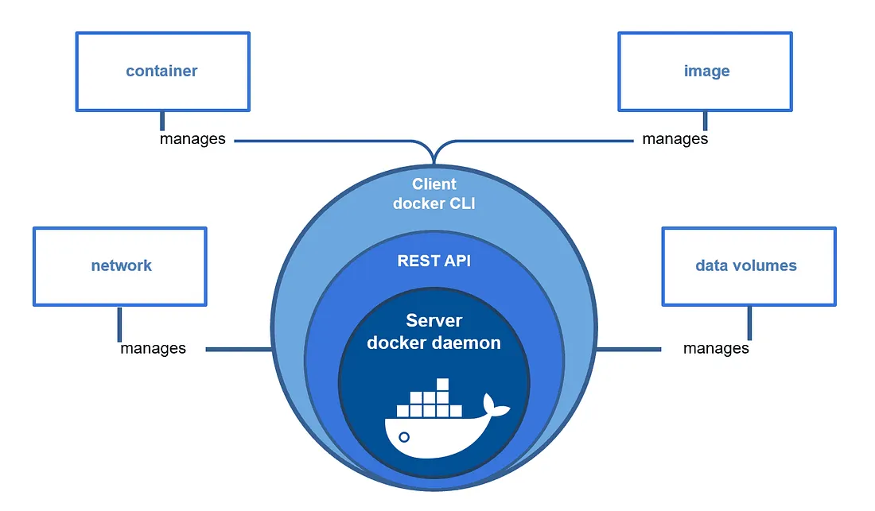
Docker Architecture
Three major components:
Docker Client — CLI
Docker Daemon (Engine) — manages images & containers
Registry — stores images

Slide 6
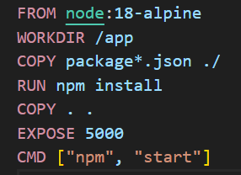
Introduction to Dockerfile
A Dockerfile is a script that tells Docker how to build an image.
Common instructions:
FROM — base image
WORKDIR — working directory
COPY — copy files
RUN — run commands
EXPOSE — expose ports
CMD — default command

Slide 7
Building & Running an Image
Build image:
docker build -t myapp .
Run container:
docker run -p 5000:5000 myapp
Verify:
docker ps

Slide 8
Understanding Ports
Containers run isolated on a port (e.g. 3000 inside).
You map them to the host.
Run container:
docker run -p 8080:5000 myapp
(Host:8080 → Container:5000)

Slide 9
Working with Volumes
Used to persist data, especially for databases.
Create and run with volume:
docker run -v mydata:/var/lib/mysql mysql:8.0
Good for:
MySQL
Postgres
MongoDB
Redis

Slide 10
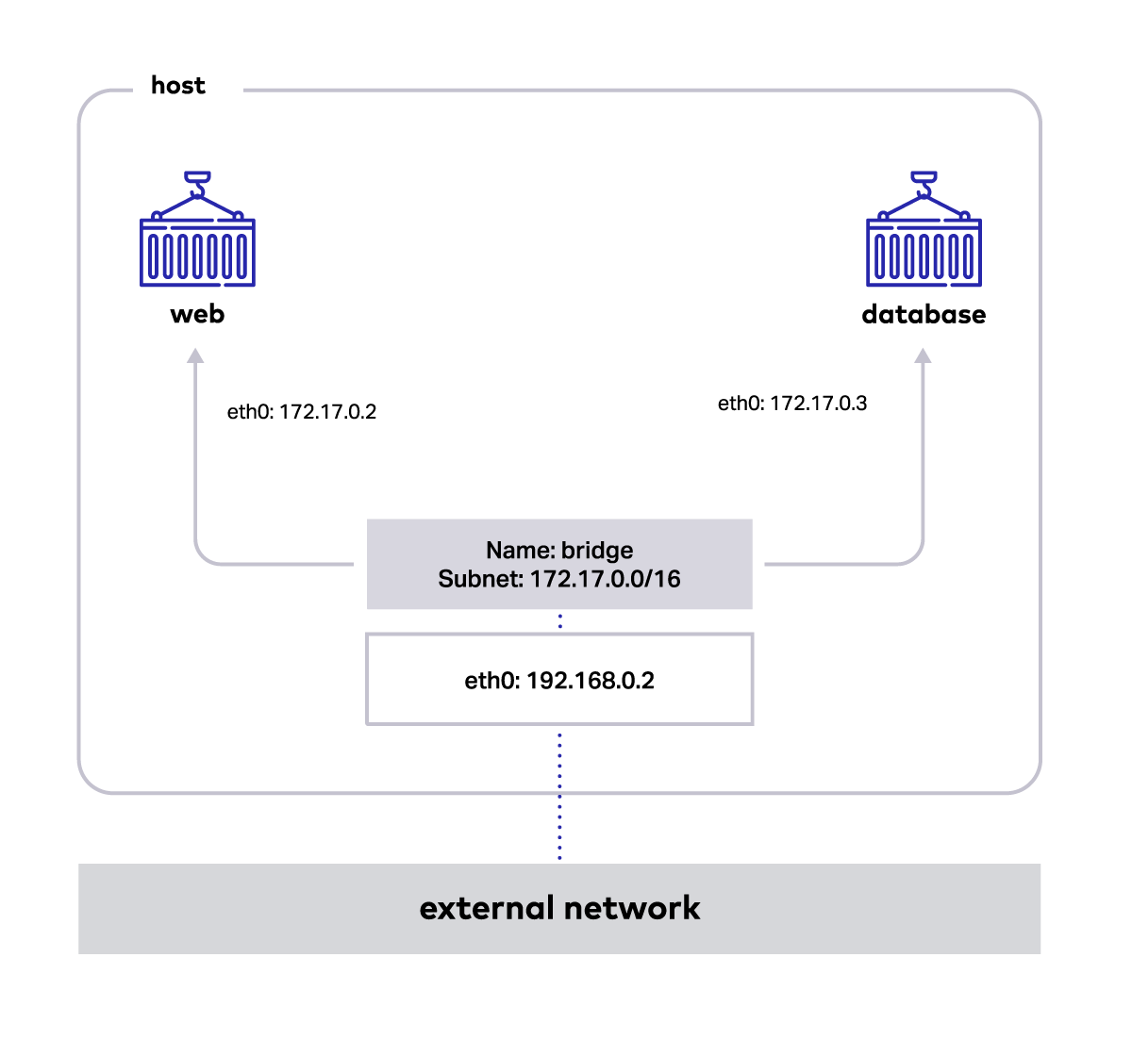
Docker Networking Basics
Containers communicate via networks.
Default network: bridge.
You can create your own:
docker network create mynet
docker run --network=mynet myservice

Slide 11
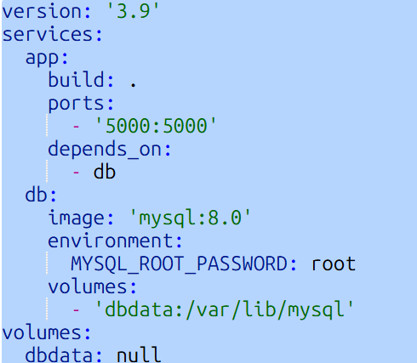
Docker Compose: Why We Need It
Running multiple containers manually is stressful.
Compose solves this by:
Defining all services in one file
Easy start/stop
Consistent environments
Common for:
Backend + Frontend
App + DB
Microservices

Slide 12
Running Docker Compose
Start all services (containers):
docker compose up -d
View containers:
docker compose ps
Stop all services:
docker compose down

Slide 13
Common Docker Commands Cheat Sheet
Common instructions:
docker ps -a — list containers
docker stop <container-id> — stop container
docker rm <container-id> — remove container
docker rmi <image> — remove image
docker pull <image> — pull image
docker logs <container- id> — container log
docker exec -it <id> /bin/bash — exec into a container
Best practices:
Use lightweight base images: alpine, slim.
Keep Dockerfile clean and modular.
Always .dockerignore unnecessary files
Use multi-stage builds for production.
Use healthchecks for stability.
See Labs for code demo

